Slide 1


Scaling Decision–Theoretic Probabilistic Programming Through Factorization
Minsung Cho, Steven Holtzen
minsung@ccs.neu.edu, s.holtzen@northeastern.edu
Programming Research Lab, Northeastern University
DRAGSTERS Workshop @ PLDI 2023

Slide 2
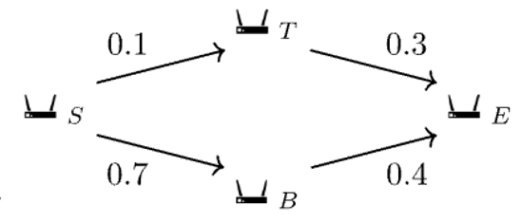
Probabilistic models and inference
Crucial in representing real-world phenomena
Primary reasoning task is probabilistic inference
Probability of some event occurring over the model
Support for Bayesian conditioning
Given that I received a packet, what’s the probability that it came from the top route?

Slide 3

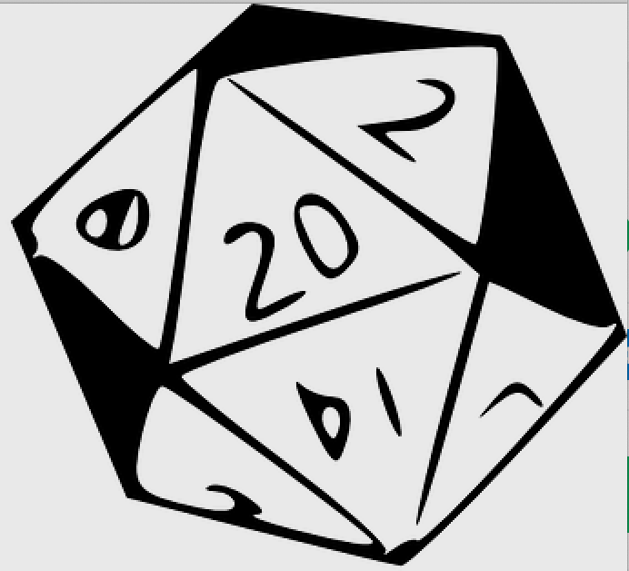

What is probabilistic programming?
Stan¹
Programming languages to specify probabilistic models
Still do probabilistic inference!
Give the probability of some event over the bound variables
Support for Bayesian conditioning
We focus on discrete probability.
Dice²
Problog³
1. Carpenter, B., Gelman, A., Hoffman, M. D., Lee, D., Goodrich, B., Betancourt, M., ... & Riddell, A. (2017). Stan: A probabilistic programming language. Journal of statistical software, 76(1).
2. Holtzen, S., Van den Broeck, G., & Millstein, T. (2020). Scaling exact inference for discrete probabilistic programs. Proceedings of the ACM on Programming Languages, 4(OOPSLA), 1-31.3
3. Fierens, D., Van den Broeck, G., Renkens, J., Shterionov, D., Gutmann, B., Thon, I., ... & De Raedt, L. (2015). Inference and learning in probabilistic logic programs using weighted boolean formulas. Theory and Practice of Logic Programming, 15(3), 358-401.

Slide 4
The probabilistic program pipeline
Probabilistic
(graphical) model
Probabilistic program
Boolean formula with weights
Probabilistic circuit representation
Probabilistic inference
Notes:
Maybe get rid of the graphical in parentheses, perhaps explain probabilistic model to inference

Slide 5
The probabilistic program pipeline
Probabilistic
(graphical) model
Probabilistic program
Boolean formula with weights
Probabilistic circuit representation
Probabilistic inference

Slide 6
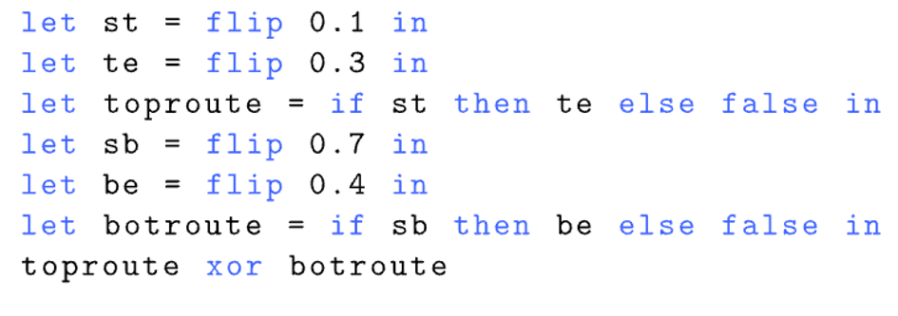
Example: The unreliable network
Probabilistic
(graphical) model
Probabilistic program

Slide 7
The probabilistic program pipeline
Probabilistic
(graphical) model
Probabilistic program
Boolean formula with weights
Probabilistic circuit representation
Probabilistic inference

Slide 8
The probabilistic program pipeline
Probabilistic
(graphical) model
Probabilistic program
Boolean formula with weights
Probabilistic circuit representation
Well-studied in PL/AI^{2,3,4}
Details are beyond scope of talk
Probabilistic inference
2. Holtzen, S., Van den Broeck, G., & Millstein, T. (2020). Scaling exact inference for discrete probabilistic programs. Proceedings of the ACM on Programming Languages, 4(OOPSLA), 1-31.3
3. Fierens, D., Van den Broeck, G., Renkens, J., Shterionov, D., Gutmann, B., Thon, I., ... & De Raedt, L. (2015). Inference and learning in probabilistic logic programs using weighted boolean formulas. Theory and Practice of Logic Programming, 15(3), 358-401.
4. Chavira, M., & Darwiche, A. (2008). On probabilistic inference by weighted model counting. Artificial Intelligence, 172(6-7), 772-799.

Slide 9
The probabilistic program pipeline
Probabilistic
(graphical) model
Probabilistic program
Boolean formula with weights
Probabilistic circuit representation
Efficient algorithm using semiring ops⁴
Basis for our novel contribution
Probabilistic inference
4. Chavira, M., & Darwiche, A. (2008). On probabilistic inference by weighted model counting. Artificial Intelligence, 172(6-7), 772-799.

Slide 10
The probabilistic program pipeline
Probabilistic
(graphical) model
Probabilistic program
Boolean formula with weights
Probabilistic circuit representation
Probabilistic inference

Slide 11

Example: Compilation
0.1
Key point: Paths from st to 1 represent assignments that satisfy our Boolean formula!
0.9
0.3
0.7
0.7
0.7
0.3
0.3
0.6
0.4
0.6
1
0
Probabilistic program
Boolean formula with weights
Probabilistic circuit representation

Slide 12
Example: Inference
0.1
For each non-root vertex, bottom-up:
Let w, v be weights on outgoing edges
Let p, q be the values of child vertices
Return wp+vq
0.9
0.3
0.7
0.4×0 + 0.6×1 = 0.6
0.4×1 + 0.6×0 = 0.4
0.3
0.7
0.7
0.3
0.4
0.6
0.6
1
0
Probabilistic circuit representation
Probabilistic inference
Notes:
Callout: efficiently represented semiring computations

Slide 13
Example: Inference
0.1
0.7×0.6 + 0.3×1 = 0.72
0.7×0.4 + 0.3×0 = 0.28
For each non-root vertex, bottom-up::
Let w, v be weights on outgoing edges
Let p, q be the values of child vertices
Return wp+vq
0.9
0.3
0.7
0.3
0.7
0.7
0.3
0.6
0.4
0.4
1
0
Probabilistic circuit representation
Probabilistic inference

Slide 14
Example: Inference
0.1
For each non-root vertex, bottom-up::
Let w, v be weights on outgoing edges
Let p, q be the values of child vertices
Return wp+vq
0.9
0.3×0.72 + 0.7×0.28 = 0.412
0.3
0.7
0.72
0.28
0.3
0.7
0.7
0.3
0.6
0.4
0.4
1
0
Probabilistic circuit representation
Probabilistic inference

Slide 15
Example: Inference
0.1
0.1×0.412 + 0.9×0.28 = 0.2932
For each non-root vertex, bottom-up::
Let w, v be weights on outgoing edges
Let p, q be the values of child vertices
Return wp+vq
0.9
0.412
0.3
0.7
0.72
0.28
0.3
0.7
0.7
0.3
0.6
0.4
0.4
1
0
Probabilistic circuit representation
Probabilistic inference

Slide 16
Example: Inference
0.293
0.1
Key point: Probabilistic circuits represent semiring computations efficiently!
For each non-root vertex, bottom-up::
Let w, v be weights on outgoing edges
Let p, q be the values of child vertices
Return wp+vq
Fact: topmost node is the answer to our inference problem!
0.9
0.412
0.3
0.7
0.72
0.28
0.3
0.7
0.7
0.3
0.6
0.4
0.4
1
0
Probabilistic circuit representation
Probabilistic inference

Slide 17
Probabilistic programs beyond inference
Probabilistic circuits factorize semiring operations for fast inference.
What other probabilistic tasks allow for factorization?
Decision-theoretic probabilistic model
Decision-theoretic probabilistic program
Boolean formula with weights
Probabilistic circuit representation
Maximum expected utility

Slide 18
Decision-theoretic probabilistic model
Decision-theoretic probabilistic program
Boolean formula with weights
Probabilistic circuit representation
Maximum expected utility(MEU)

Slide 19
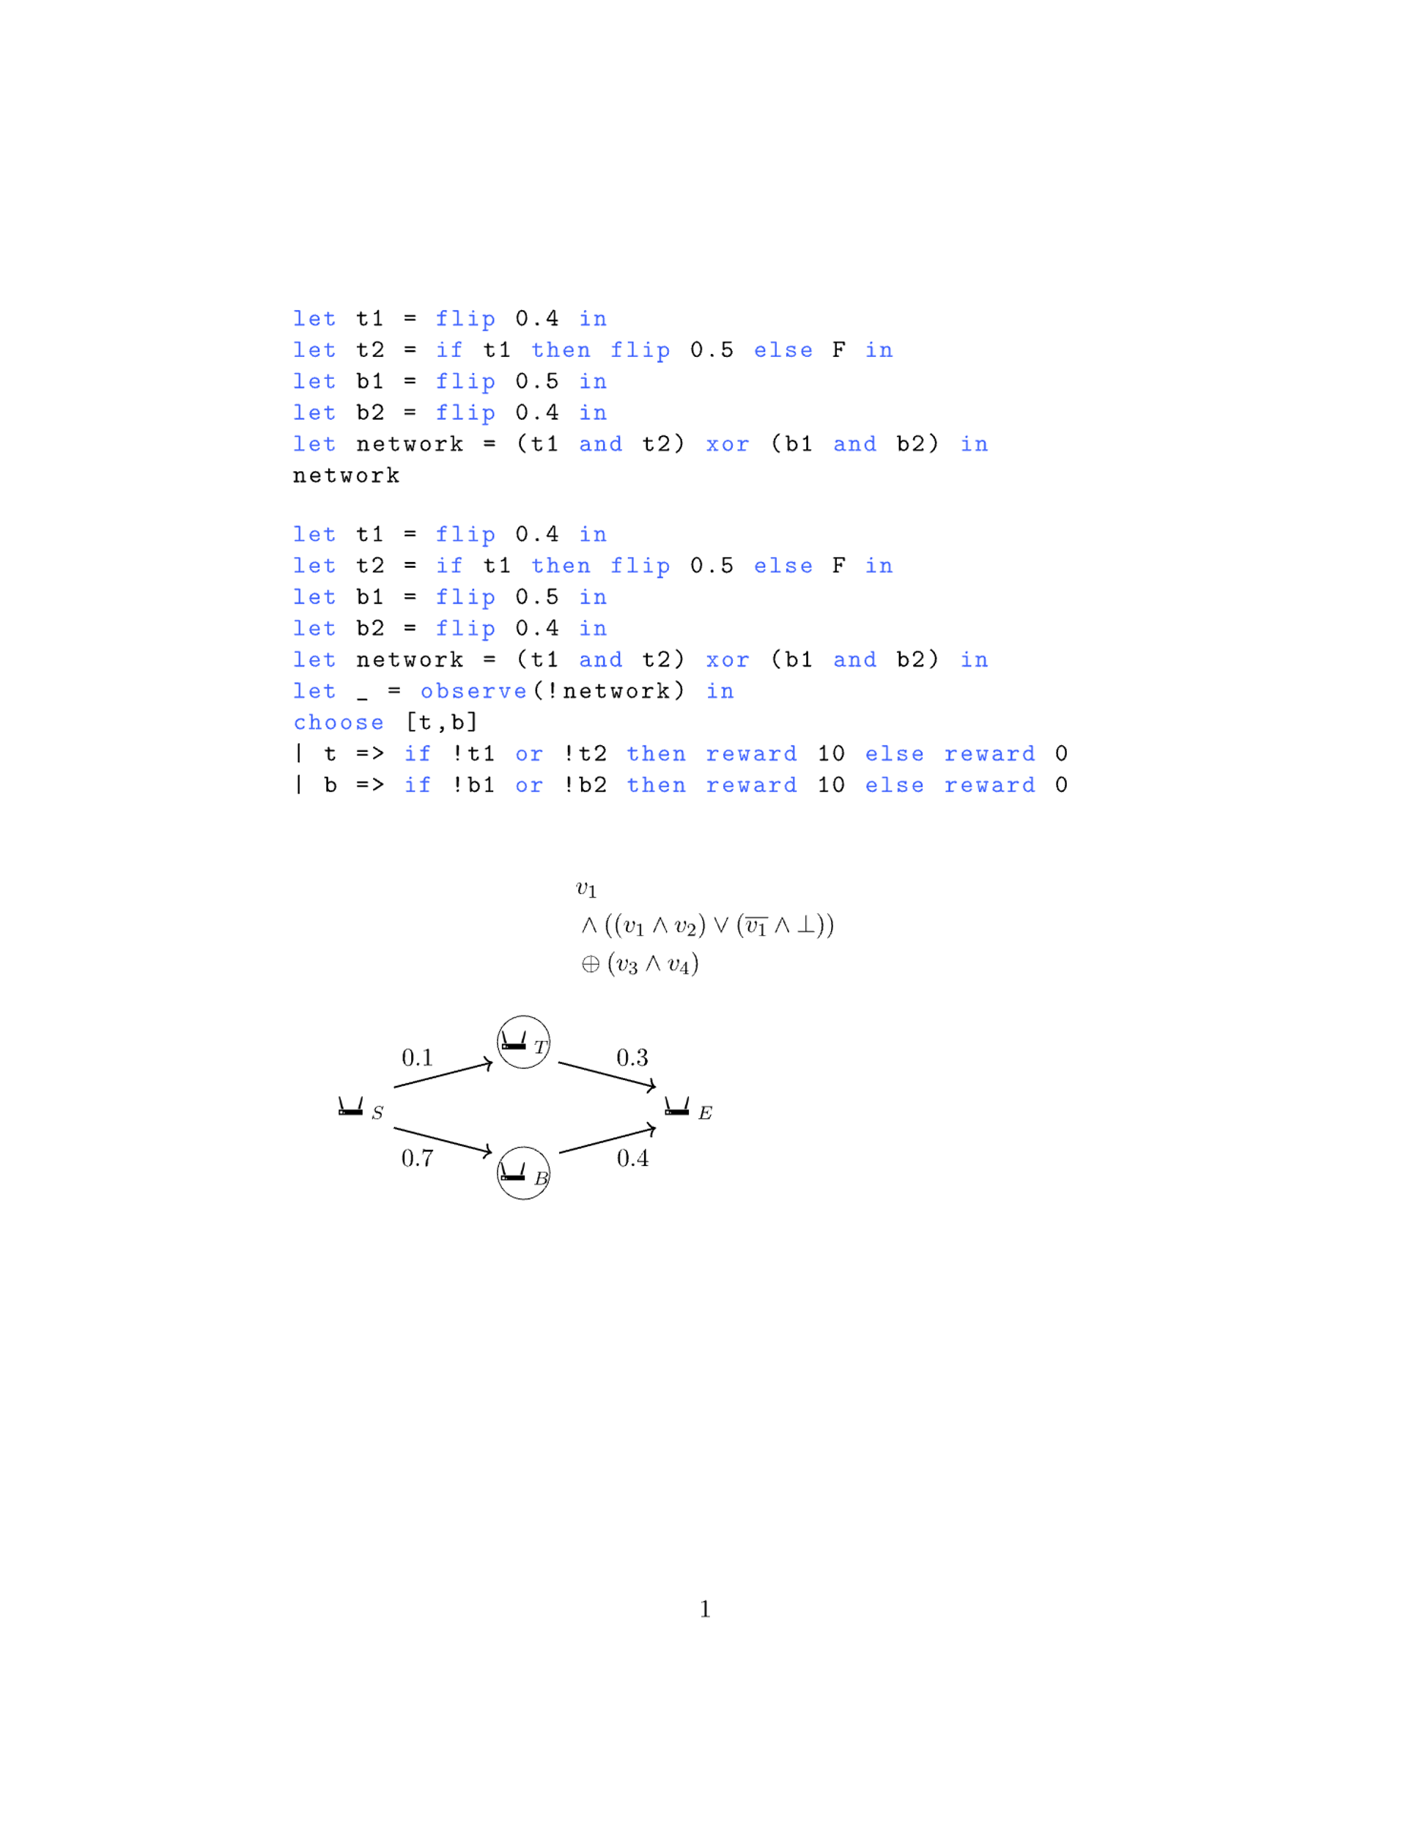
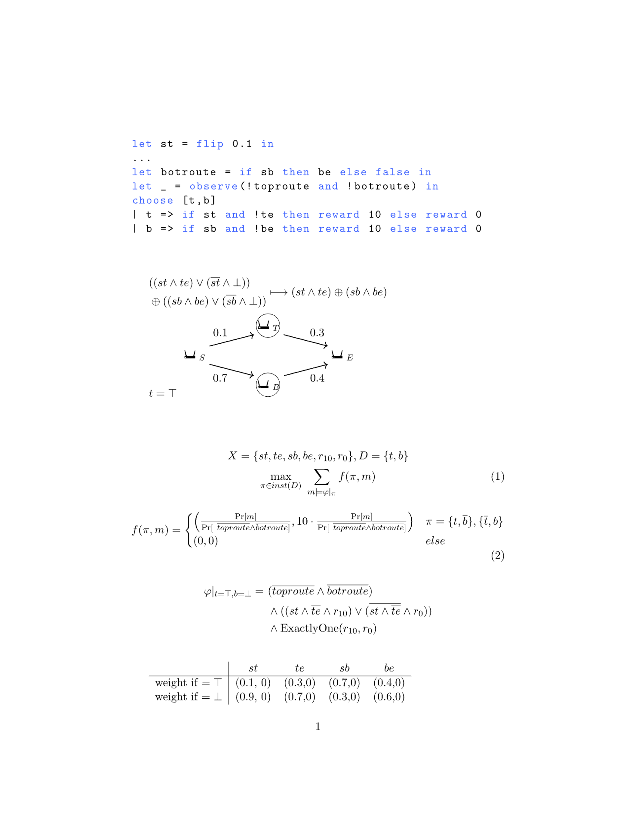
Example: Decision-Making
💰
What language features do we want?
Observations/conditioning on events
Choosing between choices (decisions)
Rewards
🔥
🚨
Decision making model
Decision making PL

Slide 20
Example: Decision-Making
💰
What language features do we want?
Observations/conditioning on events
Choosing between choices (decisions)
Rewards
🔥
🚨
Decision making model
Decision making PL

Slide 21
Example: Maximum Expected Utility
🚨
b
b=T
0
t=T
0.72
b=F
t
I shouldn’t investigate t and investigate b!
Wow, this tree is exponential in the number of choices!
t=F
b
b=F
0
b=T
5.8
Decision making model
MEU

Slide 22
Decision-theoretic probabilistic model
Decision-theoretic probabilistic program
Boolean formula with weights
Probabilistic circuit representation
Maximum expected utility (MEU)

Slide 23
Decision-theoretic probabilistic model
Decision-theoretic probabilistic program
Boolean formula with weights
Probabilistic circuit representation
All new contributions!
Weighted by the expectation semiring
Check out our SRC poster for details!
Maximum expected utility

Slide 24
Decision-theoretic probabilistic model
Decision-theoretic probabilistic program
Boolean formula with weights
Probabilistic circuit representation
Build on prior work^{5,6}
New algorithm contribution for fast MEU
Maximum expected utility
5. Kiesel, R., Totis, P., & Kimmig, A. (2022). Efficient Knowledge Compilation Beyond Weighted Model Counting. Theory and Practice of Logic Programming, 22(4), 505-522.
6. Derkinderen, V., & De Raedt, L. (2020). Algebraic circuits for decision theoretic inference and learning. In ECAI 2020 (pp. 2569-2576). IOS Press.

Slide 25
Decision-theoretic probabilistic model
Decision-theoretic probabilistic program
Boolean formula with weights
Probabilistic circuit representation
Maximum expected utility

Slide 26

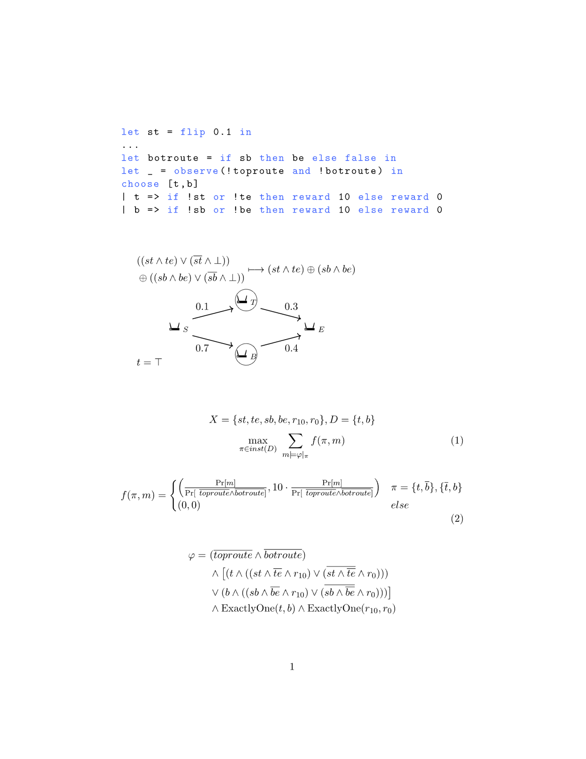
Example: Compilation
Decision-theoretic PL
Boolean formula with weights

Slide 27
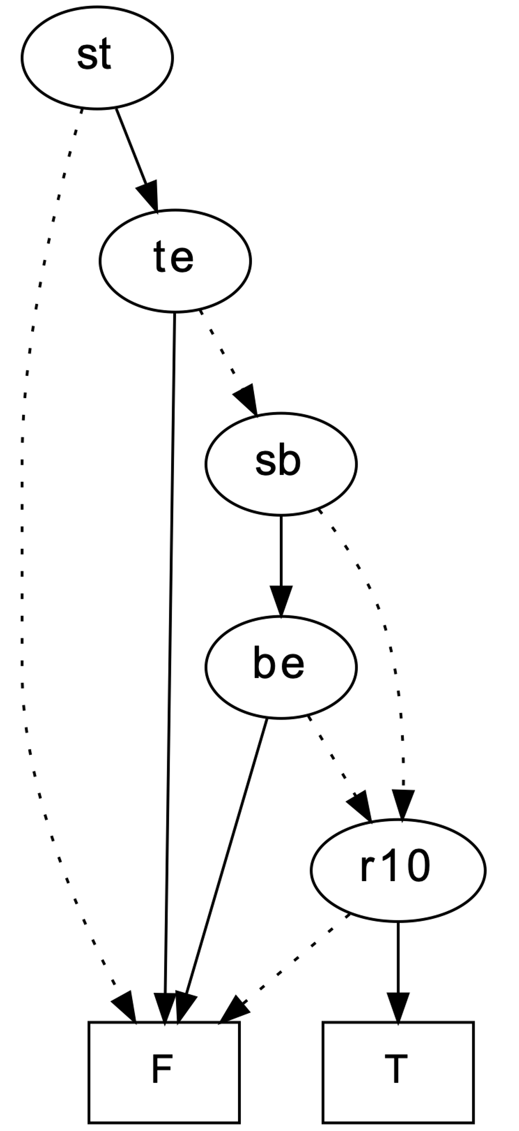
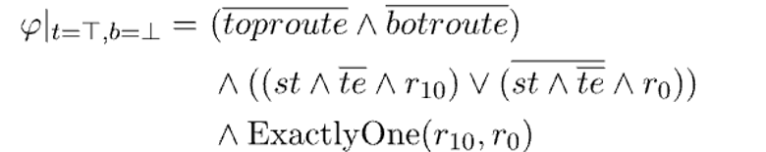
Example: Compilation
(0.1,0)
b
t
(0.7,0)
(0.3,0)
b
(0.9,0)
(0.7,0)
(0.3,0)
(0.6,0)
(0.4,0)
(1,0)
(1,10)
Decision-theoretic PL
Boolean formula with weights
PC compilation
(0,0)
(1,0)

Slide 28
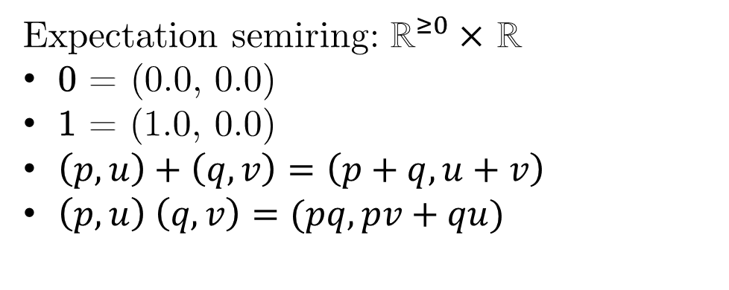
Example: Expected Utility
(0.1,0)
Expectation semiring: ${\text{ℝ}}^{≥0}×$ ℝ
0 = (0.0, 0.0)
1 = (1.0, 0.0)
$\left(p,u\right)+\left(q,v\right)=\left(p+q, u+v\right)$
$\left(p,u\right) \left(q,v\right)=(pq, pv+qu)$
(0.7,0)
(0.3,0)
(0.9,0)
(0.7,0)
For each non-root vertex, bottom-up:
Let w, v be weights on outgoing edges
Let p, q be the values of child vertices
Return wp+vq
(0.3,0)
(0.6,0)
(0.4,0)
(1,0)
(1,10)
PC Compilation
MEU
(0,0)
(1,0)

Slide 29
Example: Expected Utility
(0.1,0)
Expectation semiring: ${\text{ℝ}}^{≥0}×$ ℝ
0 = (0.0, 0.0)
1 = (1.0, 0.0)
$\left(p,u\right)+\left(q,v\right)=\left(p+q, u+v\right)$
$\left(p,u\right) \left(q,v\right)=(pq, pv+qu)$
(0.7,0)
(0.3,0)
(0.9,0)
(1,0)(1,10) + (0,0)(1,0) = (1,10)
(0.7,0)
For each non-root vertex, bottom-up:
Let w, v be weights on outgoing edges
Let p, q be the values of child vertices
Return wp+vq
(0.3,0)
(0.6,0)
(0.4,0)
(1,0)
(1,10)
PC Compilation
MEU
(0,0)
(1,0)

Slide 30
Example: Expected Utility
(0.1,0)
Expectation semiring: ${\text{ℝ}}^{≥0}×$ ℝ
0 = (0.0, 0.0)
1 = (1.0, 0.0)
$\left(p,u\right)+\left(q,v\right)=\left(p+q, u+v\right)$
$\left(p,u\right) \left(q,v\right)=(pq, pv+qu)$
(0.6,0)(1,10) + (0.4,0)(0,0) = (0.6,6)
(0.7,0)
(0.3,0)
(0.9,0)
(0.7,0)
For each non-root vertex, bottom-up:
Let w, v be weights on outgoing edges
Let p, q be the values of child vertices
Return wp+vq
(0.3,0)
(0.6,0)
(0.4,0)
(1,10)
(1,0)
(1,10)
PC Compilation
MEU
(0,0)
(1,0)

Slide 31
Example: Expected Utility
(0.7,0)(0.6,6) + (0.3,0)(1,10) =
(0.42, 4.2) + (0.3, 3) =
(0.72, 7.2)
(0.1,0)
Expectation semiring: ${\text{ℝ}}^{≥0}×$ ℝ
0 = (0.0, 0.0)
1 = (1.0, 0.0)
$\left(p,u\right)+\left(q,v\right)=\left(p+q, u+v\right)$
$\left(p,u\right) \left(q,v\right)=(pq, pv+qu)$
(0.7,0)
(0.3,0)
(0.9,0)
(0.7,0)
For each non-root vertex, bottom-up:
Let w, v be weights on outgoing edges
Let p, q be the values of child vertices
Return wp+vq
(0.3,0)
(0.6,6)
(0.6,0)
(0.4,0)
(1,10)
(1,0)
(1,10)
PC Compilation
MEU
(0,0)
(1,0)

Slide 32
Example: Expected Utility
(0.1,0)
(0.3,0)(0,0) + (0.7,0)(0.72, 7.2) =
(0.50, 0.50)
Expectation semiring: ${\text{ℝ}}^{≥0}×$ ℝ
0 = (0.0, 0.0)
1 = (1.0, 0.0)
$\left(p,u\right)+\left(q,v\right)=\left(p+q, u+v\right)$
$\left(p,u\right) \left(q,v\right)=(pq, pv+qu)$
(0.7,0)
(0.3,0)
(0.72,7.2)
(0.9,0)
(0.7,0)
For each non-root vertex, bottom-up:
Let w, v be weights on outgoing edges
Let p, q be the values of child vertices
Return wp+vq
(0.3,0)
(0.6,6)
(0.6,0)
(0.4,0)
(1,10)
(1,0)
(1,10)
PC Compilation
MEU
(0,0)
(1,0)

Slide 33
Example: Expected Utility
(0.1,0)
(0.9,0)(0,0) + (0.1,0)(0.5, 5) =
(0.05, 0.5)
(0.5,5)
Expectation semiring: ${\text{ℝ}}^{≥0}×$ ℝ
0 = (0.0, 0.0)
1 = (1.0, 0.0)
$\left(p,u\right)+\left(q,v\right)=\left(p+q, u+v\right)$
$\left(p,u\right) \left(q,v\right)=(pq, pv+qu)$
(0.7,0)
(0.3,0)
(0.72,7.2)
(0.9,0)
(0.7,0)
For each non-root vertex, bottom-up:
Let w, v be weights on outgoing edges
Let p, q be the values of child vertices
Return wp+vq
(0.3,0)
(0.6,6)
(0.6,0)
(0.4,0)
(1,10)
(1,0)
(1,10)
PC Compilation
MEU
(0,0)
(1,0)

Slide 34
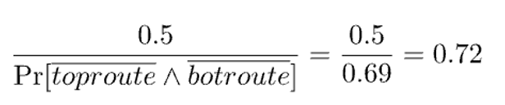
Example: Expected Utility
(0.05,0.5)
(0.1,0)
Key point: The probabilistic circuit represents expected utility given our decisions!
(0.5,5)
Expectation semiring: ${\text{ℝ}}^{≥0}×$ ℝ
0 = (0.0, 0.0)
1 = (1.0, 0.0)
$\left(p,u\right)+\left(q,v\right)=\left(p+q, u+v\right)$
$\left(p,u\right) \left(q,v\right)=(pq, pv+qu)$
(0.7,0)
(0.3,0)
(0.72,7.2)
(0.9,0)
(0.7,0)
For each non-root vertex, bottom-up:
Let w, v be weights on outgoing edges
Let p, q be the values of child vertices
Return wp+vq
(0.3,0)
(0.6,6)
(0.6,0)
(0.4,0)
(1,10)
(1,0)
(1,10)
PC Compilation
MEU
(0,0)
(1,0)

Slide 35
A branch-and-bound approach to MEU
ub = 5.8
t
b
b
0
0.72
5.8
0

Slide 36
A branch-and-bound approach to MEU
t
ub = 5.8
b
b
0
0.72
5.8
0

Slide 37
A branch-and-bound approach to MEU
lb = 0
t
b
b
ub = 0
0
0.72
5.8
0

Slide 38
A branch-and-bound approach to MEU
lb = 0
t
b
b
ub = 5.8
0
0.72
5.8
0

Slide 39
A branch-and-bound approach to MEU
lb = 5.8
t
ub = 0.72
b
b
0
0.72
5.8
0

Slide 40
New: Factorized nested decision making?
ub = ?
t
Partial utility computation (on a PC)
b
b
Total computation (on a PC)
Total computation (on a PC)
Total computation (on a PC)

Slide 41
New: What is the right upper bound?
For each non-root vertex, bottom-up:
Let w, v be weights on outgoing edges
Let p, q be the values of child vertices
If the vertex is not a choice:
Return wp+vq
If the vertex is a choice:
Return max(wp, vq)
max((a,b), (c,d)) = (max(a,c), max(b,d))

Slide 42
Concluding remarks and themes
Probabilistic circuits provide factorized representations of semiring computations (semiring semantics over Booleans).
Semiring computations are an essential component in compiling probabilistic programming languages.
We provide a new algorithm on top of prob. circuits that calculates maximum expected utility.
It is easily generalizable to a broad class of semirings, proven fully correct, and outperforms current SotA solvers!
(Implemented in Rust, check it out at https://github.com/neuppl/rsdd)

Slide 43

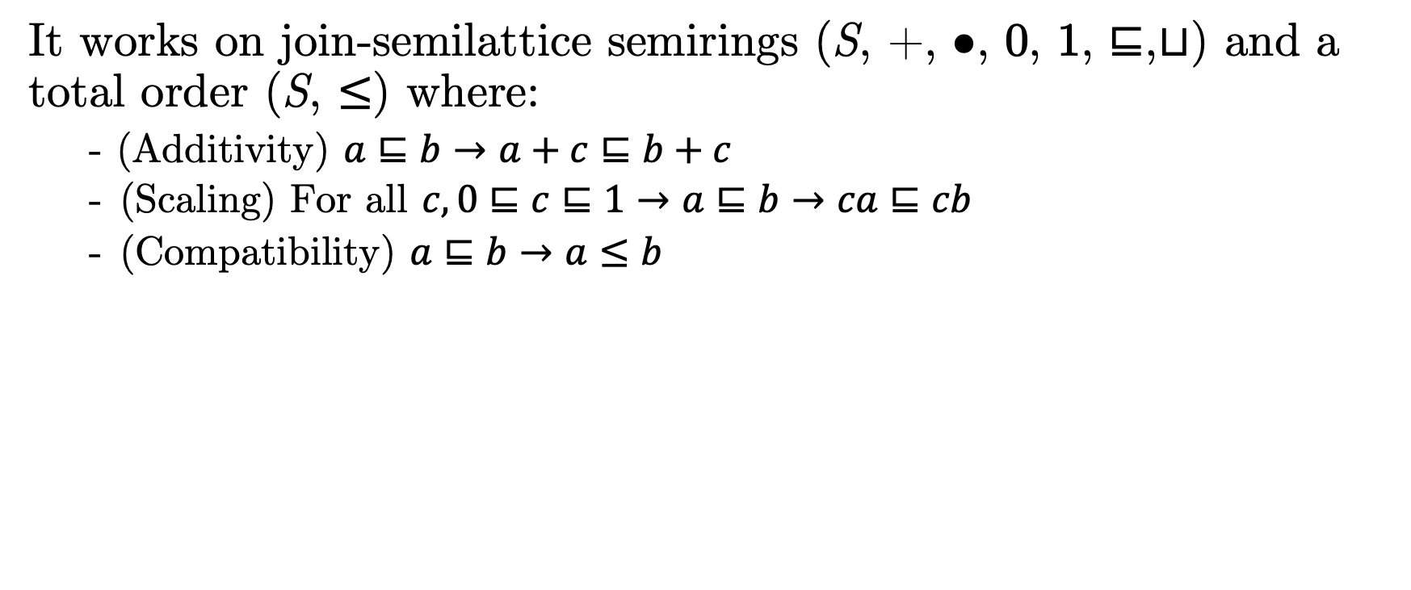

Generalizing the branch-and-bound
It works on join-semilattice semirings (S, +, •, 0, 1, $⊑$,$⊔$) and a total order (S, $≤$) where:
- (Additivity) $a⊑b→a+c⊑b+c$
(Scaling) For all $c, 0⊑c⊑1→a⊑b→ca⊑cb$
(Compatibility) $a⊑b→a≤b$
a
b
a+c
b+c
$$⊑$$
$$⊑$$

Slide 44
Generalizing the branch-and-bound
It works on join-semilattice semirings (S, +, •, 0, 1, $⊑$,$⊔$) and a total order (S, $≤$) where:
- (Additivity) $a⊑b→a+c⊑b+c$
(Scaling) For all $c, 0⊑c⊑1→a⊑b→ca⊑cb$
(Compatibility) $a⊑b→a≤b$
a
b
ca
cb
$$⊑$$
$$⊑$$
a
b

Slide 45

Generalizing the branch-and-bound
It works on join-semilattice semirings (S, +, •, 0, 1, $⊑$,$⊔$) and a total order (S, $≤$) where:
- (Additivity) $a⊑b→a+c⊑b+c$
(Scaling) For all $c, 0⊑c⊑1→a⊑b→ca⊑cb$
(Compatibility) $a⊑b→a≤b$
a
b
a
b
$$⊑$$
as partially computed values
$$≤$$
as totally computed values

Slide 46
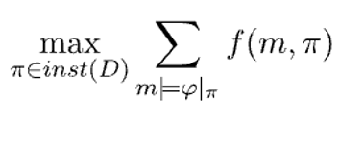
What do we solve?
We solve problems of the form:
where f factorizes over the literals in its arguments.
Marginal MAP
Exact maximum likelihood calculation
Maximum expected utility
(Variants of) weighted partial MAXSAT
…and more?

